Slide 1


PG-DAC MAR-2023
INSTITUTE FOR ADVANCED COMPUTING AND
SOFTWARE DEVELOPMENT, AKURDI, PUNE
A Presentation on
Style-Hub Online Shopping App
Project Guide
Mrs. Sonali Mogal
Project By-
Ankit Lipate(233013)
Siddhant Moon(233095)

Slide 2
Style-hub
Online Shopping App

Slide 3
Problem Arises
Product Quality Issue
Extra Hidden Charges
Payment Failure
Delayed Delivery

Slide 4
Solution
Customers will believe that the products are of top quality based on clear approval marks awarded by company.
Always display total price including shipping, tax, handling charges.
Always check the service doesn’t crash.
You need to provide order tracking details, so customers can easily track the progress of the shipment.

Slide 5
Description
Shop the latest fashion trends effortlessly with our online clothing shopping app. Discover a wide selection of stylish apparel, enjoy secure payments, easy returns, and personalized recommendations. Elevate your style with us today..!

Slide 6
Technologies Used
Backend:-
J2EE,SpringBoot,MySQL,Spring Data JPA
Frontend:-
HTML, CSS, ReactJs
Frontend and Backend connection with the help of Axios through REST API

Slide 7
Database Design
Created database according to ER diagram
Inserted data with the help of SQL queries
Problem:-
Every time required to SQL queries to fill the data into database
Solution:-
So we used the Spring Data JPA to insert data directly into database

Slide 8
Backend
Entity : Variable defining and dataset method and override ( override the string method and give output in string format).
DAO(Data access object) : data access through query, Dao is a repository (JPA : java persistence API)

Slide 9
Backend
DTOS(data transfer /transaction object) : storing the data from frontend and store in the database
Service : services we can used for CRUD operation, service layer used repository(DAO/DTOS) to perform the CURD operation. Also called as business logic.
Controller : controller accept request from user go to the service layer and work on the request which is sent by user.

Slide 10
Frontend
Header:- Created Navbar using ReactJs which is common for all pages
Footer:-Provide information about service center contact info, services and near by service center
Pages:-
About Us
Contact Us

Slide 11
Home
About Us
Contact Us
Register User
Login User

Slide 12
Frontend
Index.html :- Basic static web page
Admin functionality pages :-
Admin
Add Category
Add Product
All Orders
Delete Products
Delete User
Assign Order

Slide 13
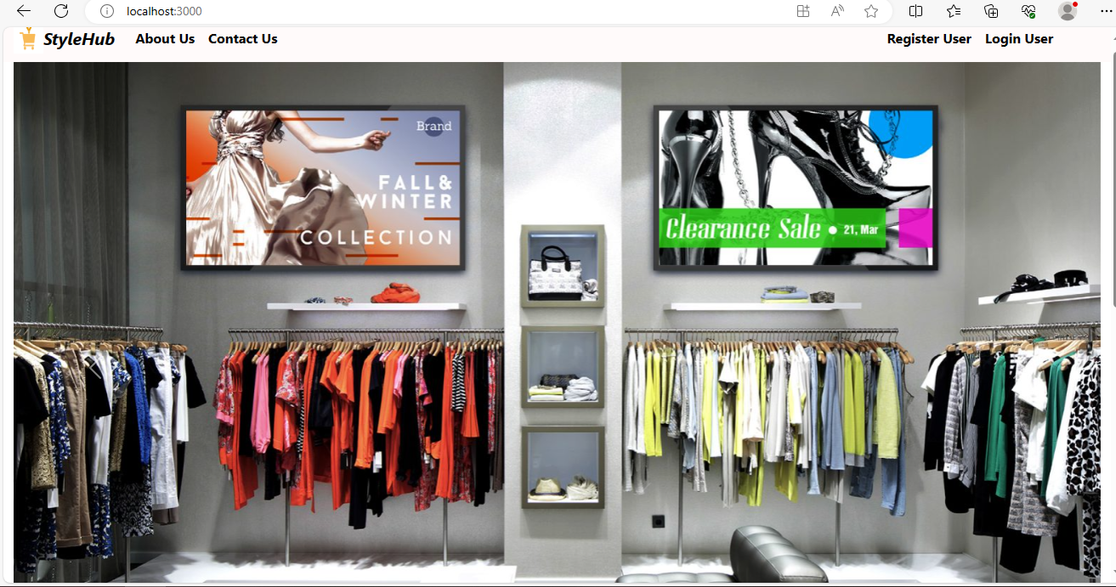
Home page

Slide 14
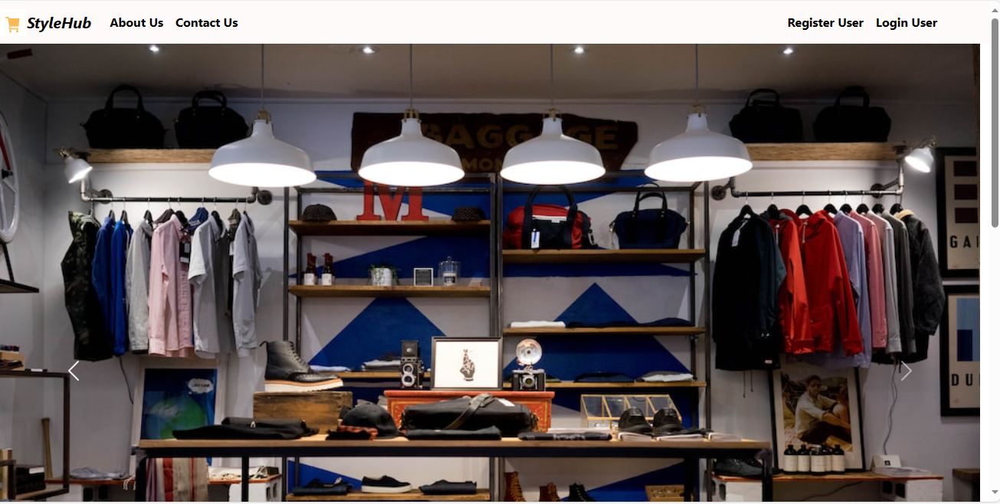
Home page

Slide 15
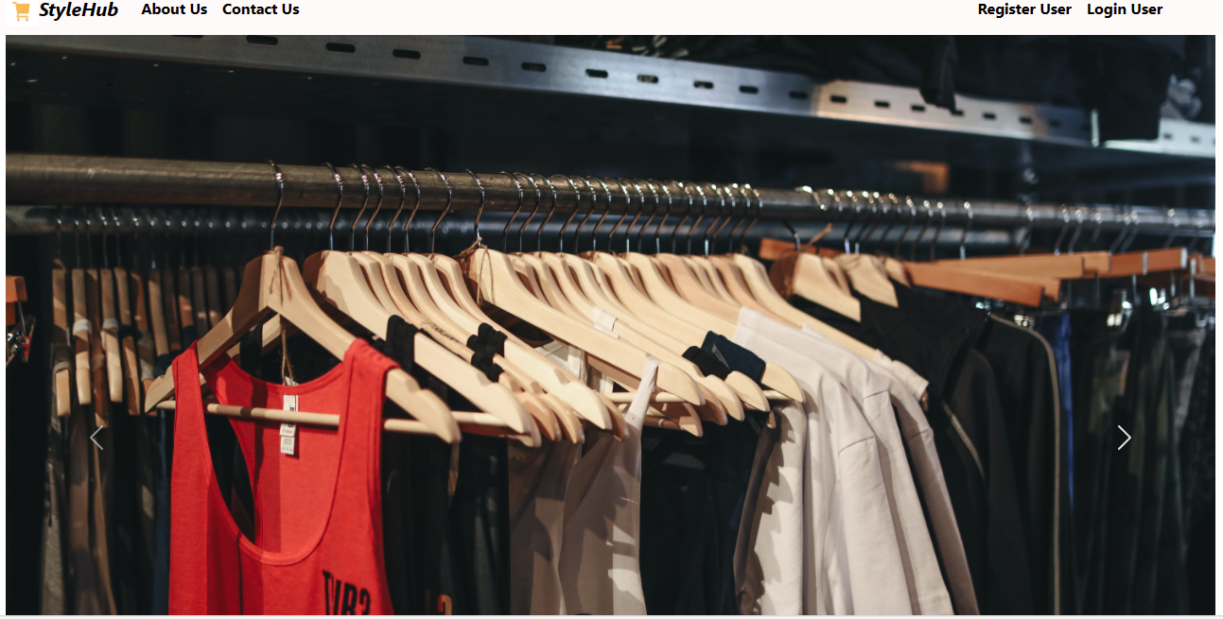
Home page

Slide 16
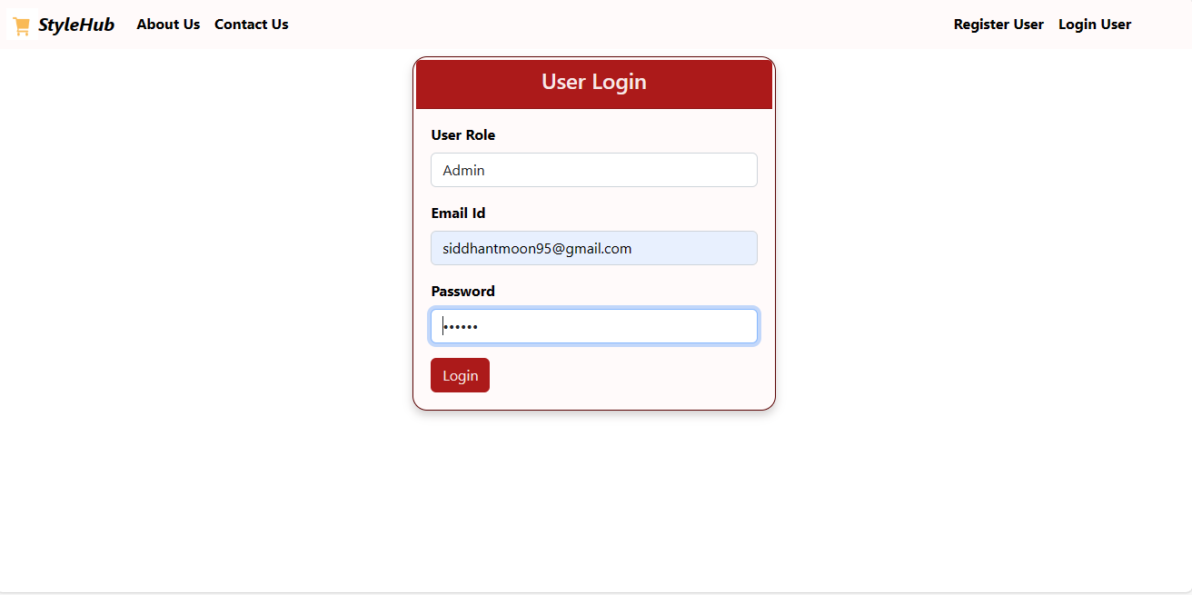
Admin Login

Slide 17
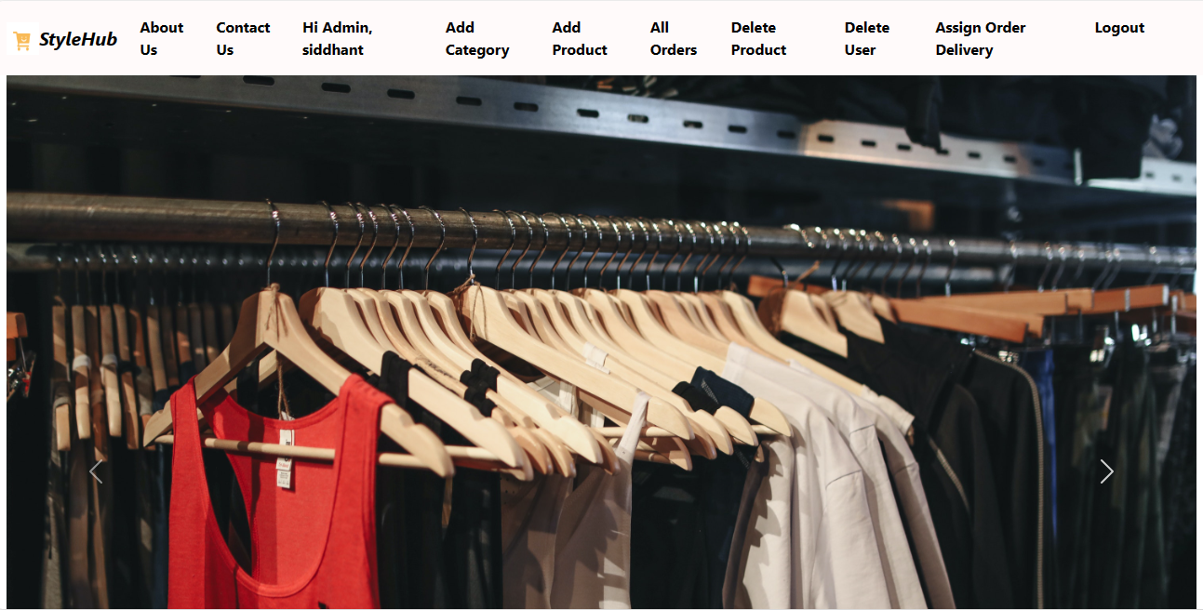
Admin Functionalities

Slide 18
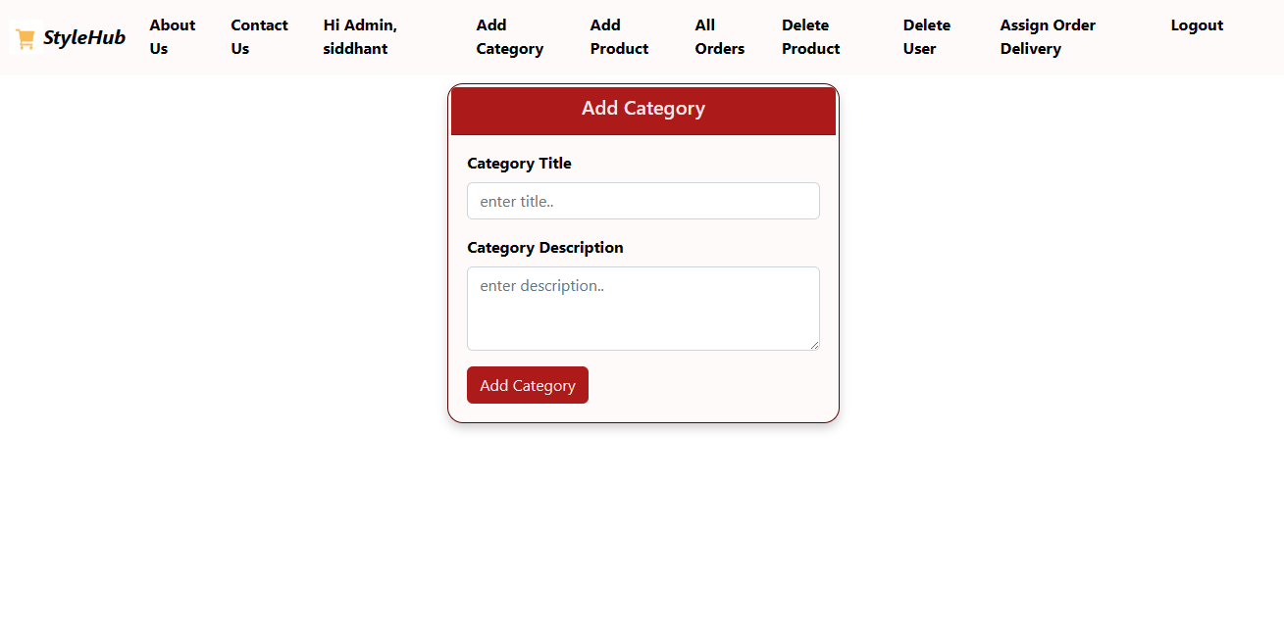
Add Features

Slide 19
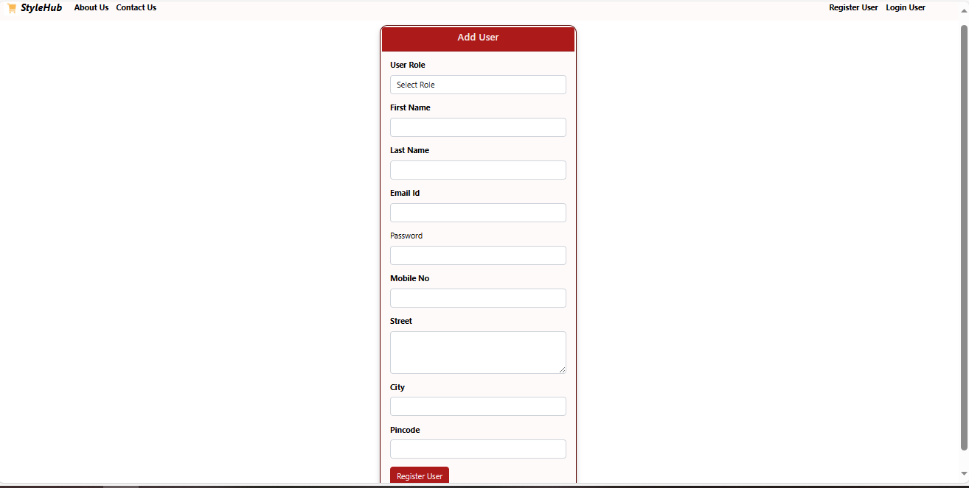
Signup

Slide 20
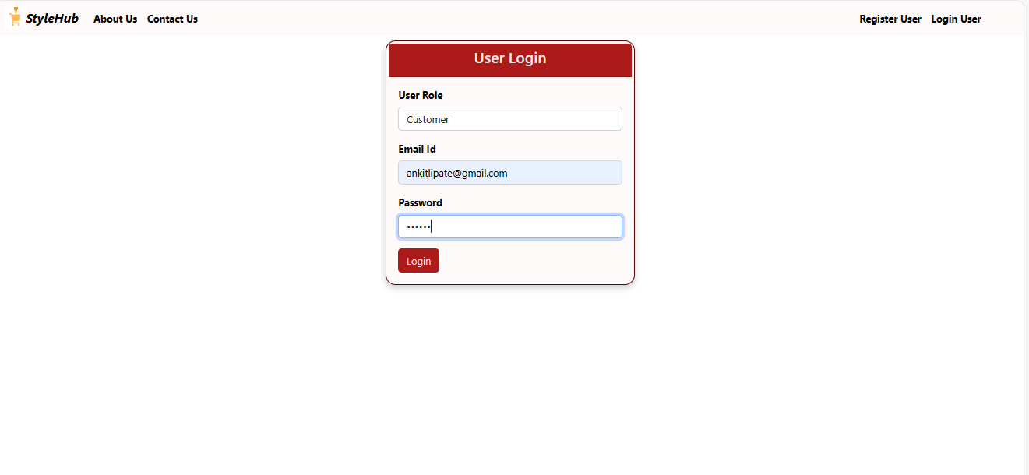
Sign in

Slide 21
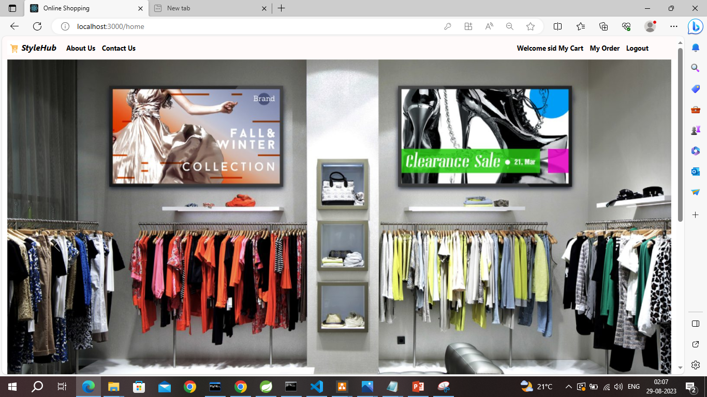
Sign in Successful

Slide 22
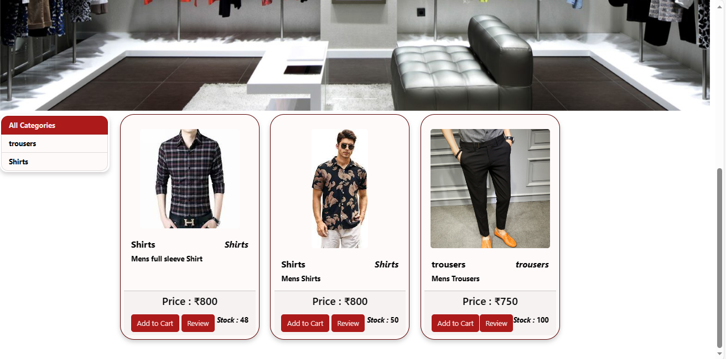
All Categories

Slide 23
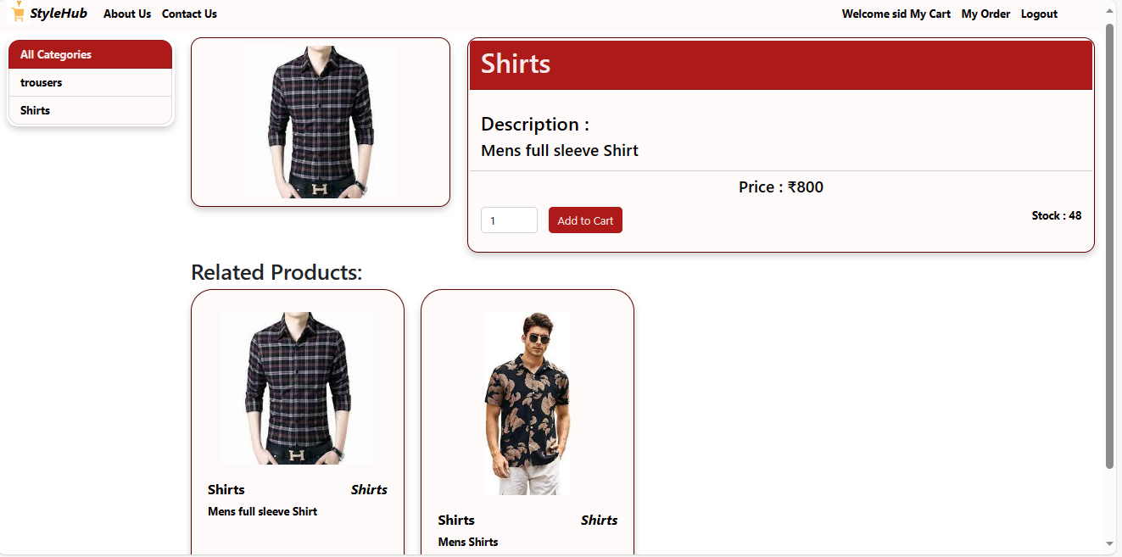
Add to Cart

Slide 24
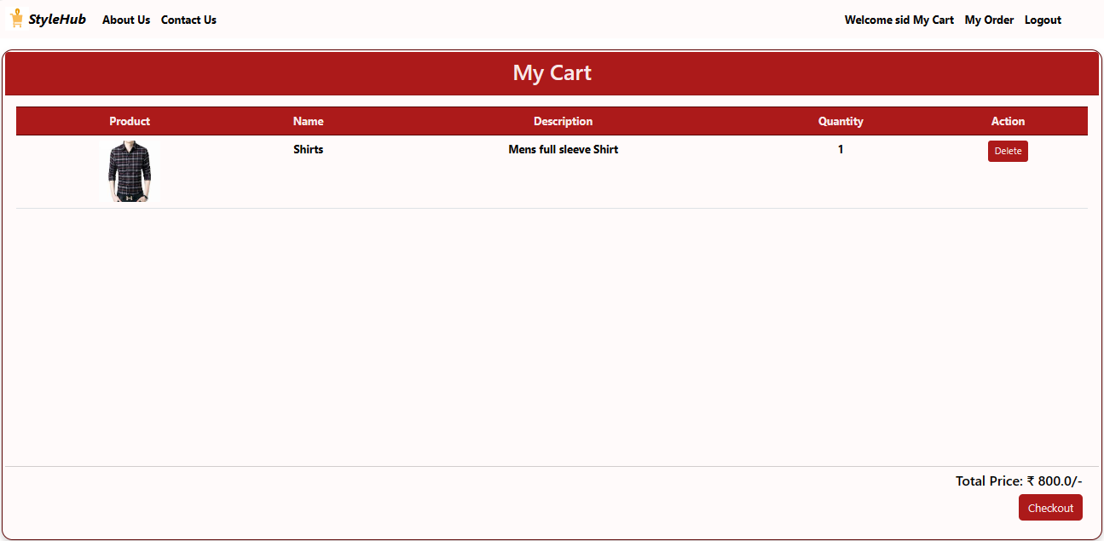
My Cart

Slide 25
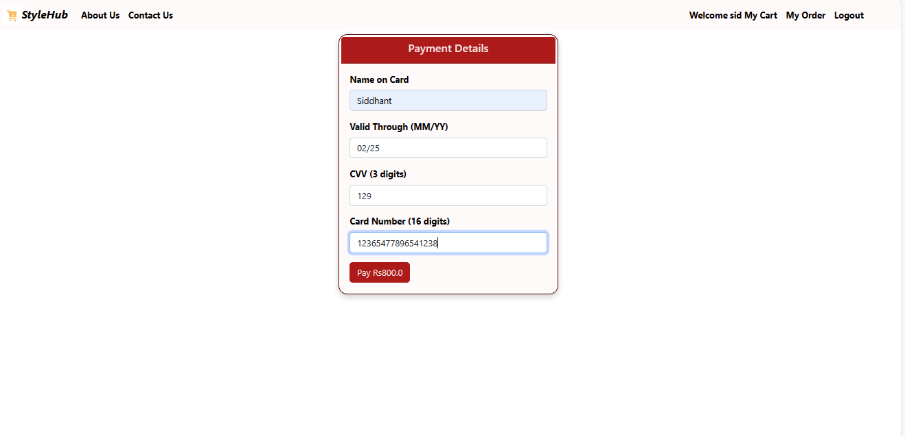
Payment Details

Slide 26
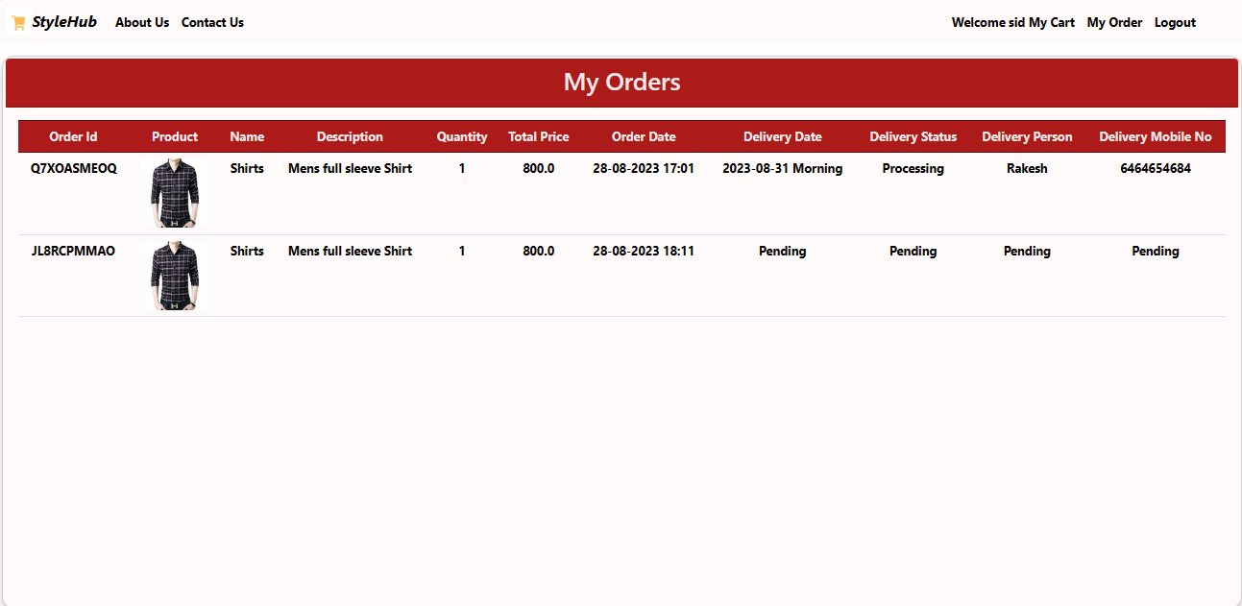
My Orders

Slide 27
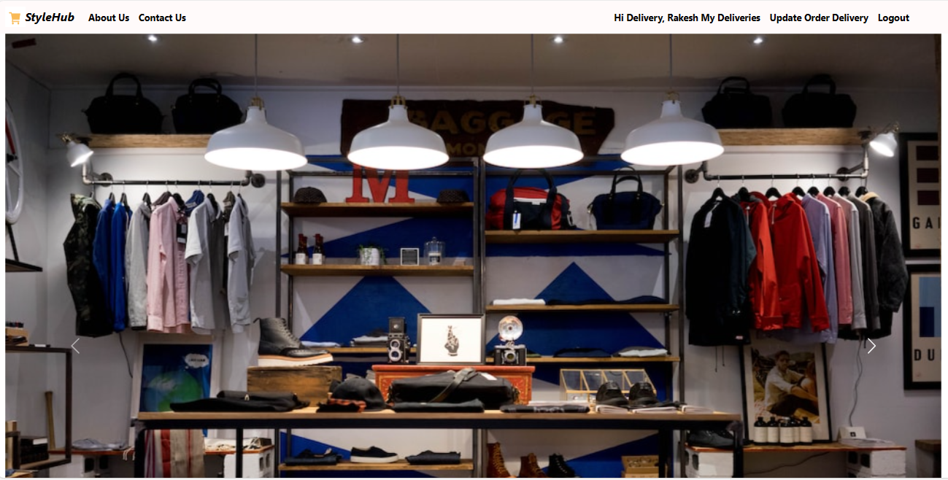
Login as a Delivery Person

Slide 28
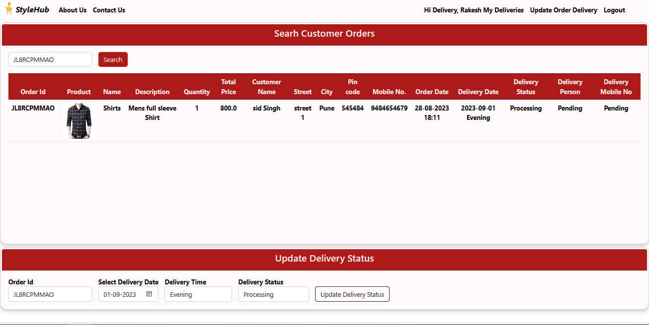
Search Customer Orders

Slide 29
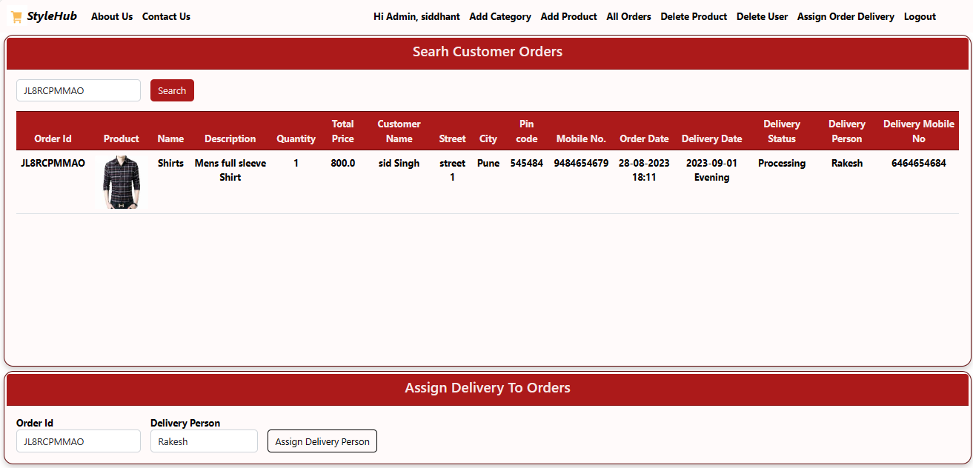
Assign Delivery to Orders

Slide 30
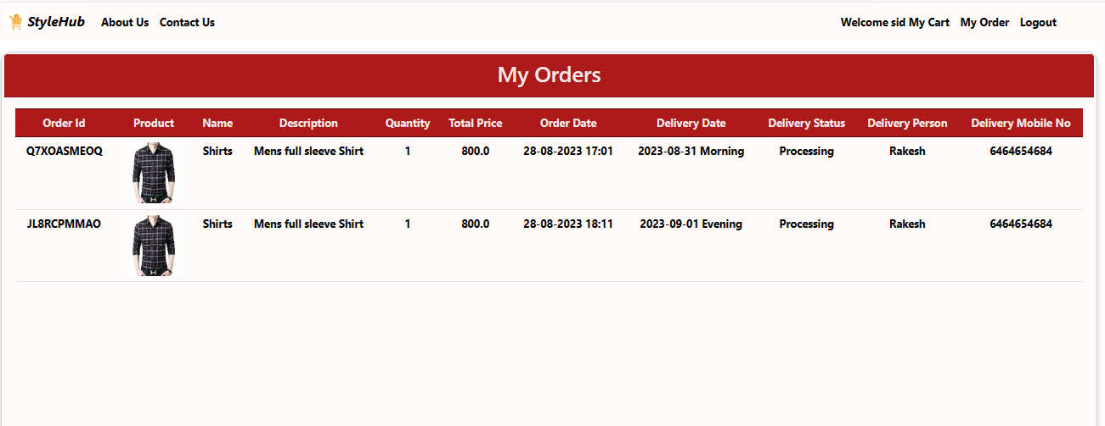
Tracking My Oders

Slide 31
Future Scope
Cash on Delivery
Online Payment Method
Tracking Order through E-mail service
Employees Management
Order Cancellation and Return Policy
Payment with UPI

Slide 32
Thank You….

